Slide 1
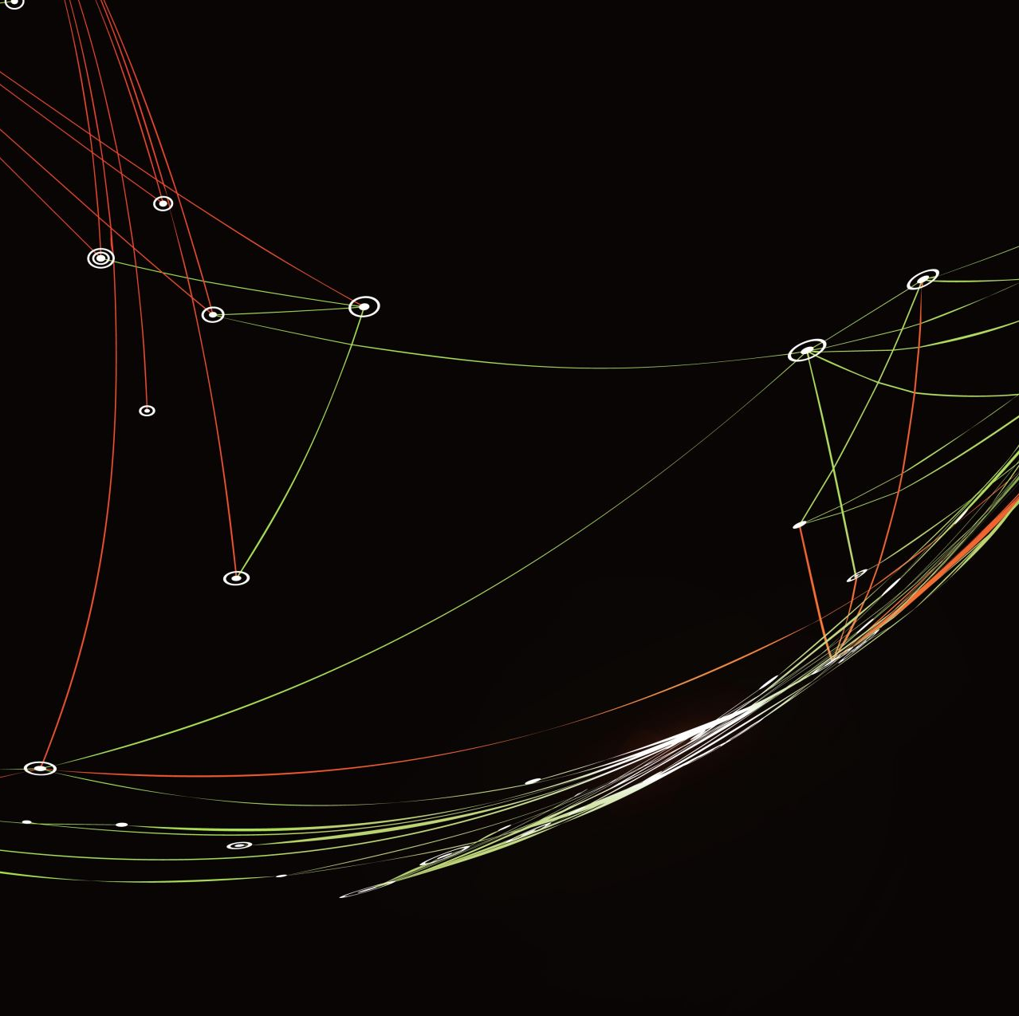
Obesity Levels Prediction From Lifestyle and Health Factors Using Data Mining Techniques
DATA 240 – Final Project
Group 4:
Kunal Agrawal
Sai Srimai Kommamuri
Supriya Kamble
Swathi Kasarabada

Slide 2
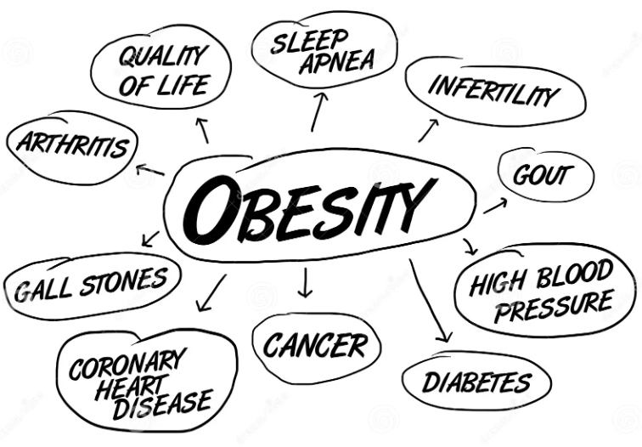
Introduction:
Obesity is a complex issue influenced by various factors, including genetics, learned behaviors, unhealthy diets, and sedentary lifestyles.
The causes of obesity extend beyond individual choices to include broader elements like dietary standards, physical activity levels, and chronic overeating.
Obesity has significant and widespread consequences, leading to health issues such as diabetes, cardiovascular diseases, certain cancers, mental health disorders, respiratory problems, and a diminished quality of life.
Body Mass Index (BMI) is a commonly used method for assessing fat levels and analyzing obesity levels involving the division of an individual's weight in kilograms by the square of their height in meters.
Motivation:
Early Detection and Prevention:
Empowers proactive measures to prevent obesity.
Reduces burden on healthcare systems.
Enhances overall population health.
Advancing Scientific Knowledge:
Contributes valuable insights to scientific literature and guides future studies in obesity research.
Personalized Healthcare:
Enables healthcare providers to offer tailored interventions.
Enhances treatment effectiveness.
Improves patient outcomes, reducing obesity-related complications.

Slide 3

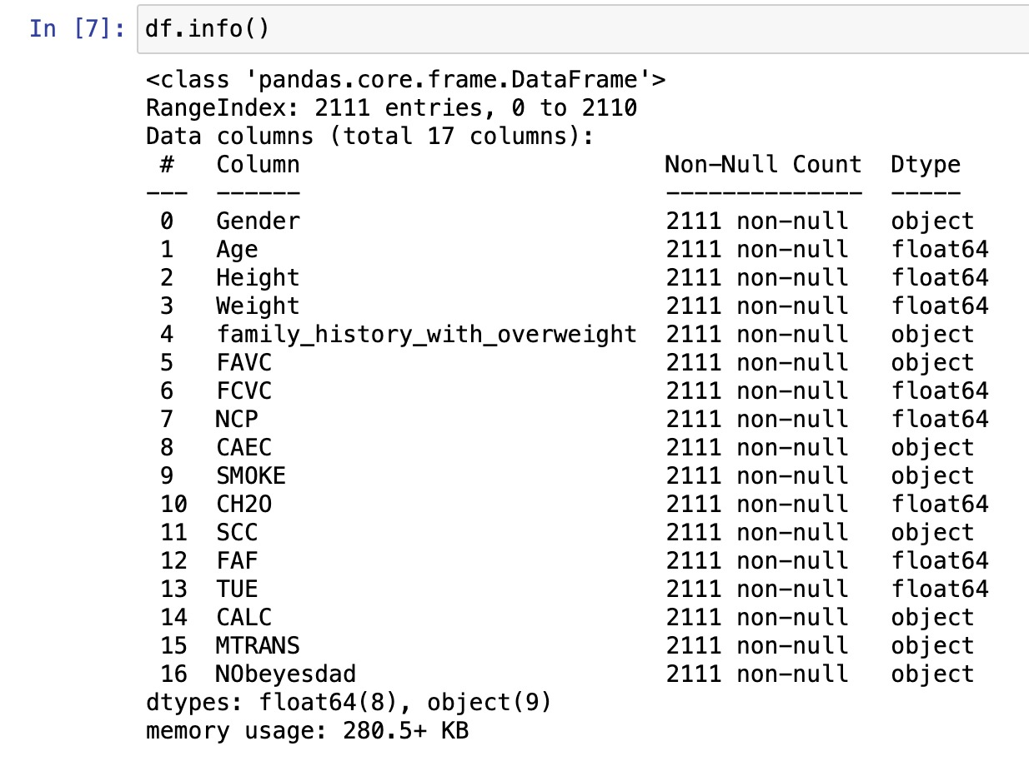
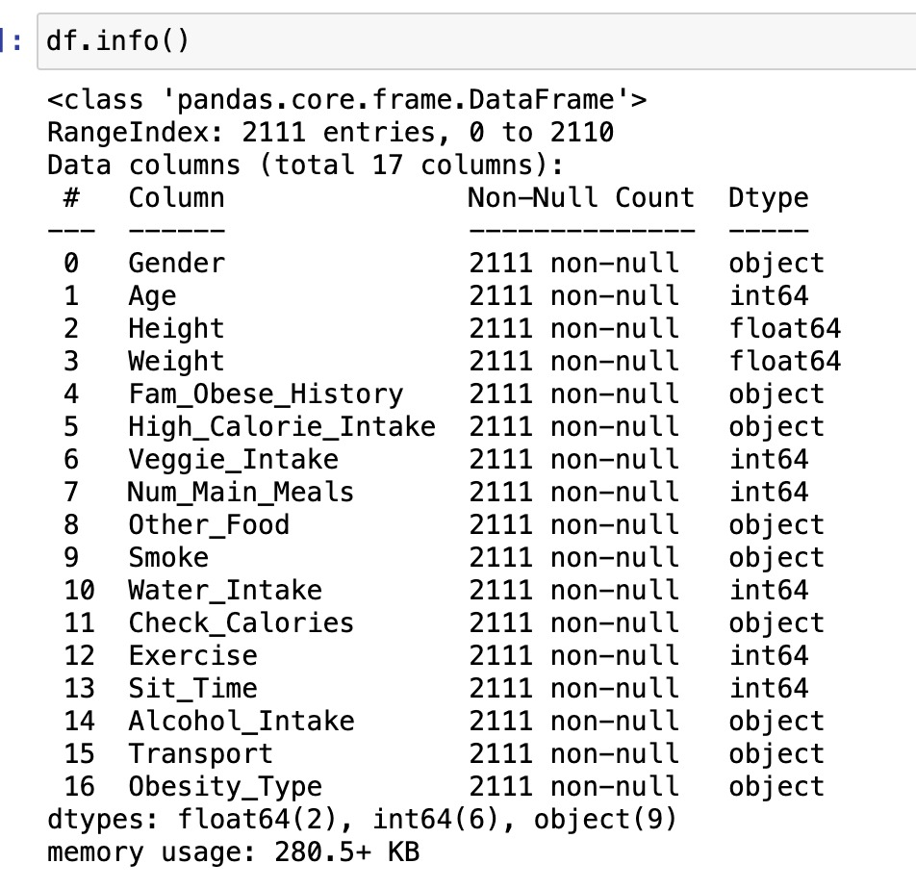
Dataset Description
The dataset for this project is sourced from the UCI Irvine Machine Learning Repository.
It includes data for the estimation of obesity levels in individuals from the countries of Mexico, Peru and Colombia, based on their eating habits and physical conditions.
Consist of 2111 records and 17 columns.
Dataset Link: https://archive.ics.uci.edu/dataset/544/estimation+of+obesity+levels+based+on+eating+habits+and+physical+condition
Original Dataset: Dataset after renaming the columns:

Slide 4
Literature Survey
Research Paper | Dataset | Methodologies | Key Points | Best Method
A machine learning approach for obesity risk prediction | Data is collected from people, who are prone to Obesity in Bangladesh | Applied various ML models: Random Forest, Logistic Regression-NN, SVM etc. | PCA has been applied in this research which resulted in higher accuracy | Logistic regression yielded the highest accuracy at 97.09%
Age-specific risk factors for the prediction of obesity using a machine learning approach | South Korean KNHANES datasets contains data from 19 to 79 years of age between 2016 and 2019 | SVM, LR, RF, MLP, LGBM, and XGB | The significant features are, for males it is ALT (SGPT) and for females it's triglyceride. Age and gender play a major role in predicting obesity risk | The ML algorithms for M and F 19-39 age achieved 70% accuracy & AUC whereas 60–79 age group has around 65% accuracy & AUC
Predicting Obesity in Adults Using Machine Learning Techniques: An Analysis of Indonesian Basic Health Research 2018 | RISKESDAS Survey data | Logistic Regression, CART, and Naïve Bayes | An increased prevalence of obesity has been caused by highly processed foods and a decrease in physical activity | Highest accuracy is achieved by Logistic Regression and CART methods
Machine learning Techniques to Predict Overweight or Obesity | Data is collected during the survey like age, height, weight etc. | 8 ML have been used SVM, DT, k-NN, RF, GB, XGB, MLP and GNB | Models used in this research are validated by 10-fold CV. Random search is used to find the hyperparameters | Random Forest came out to be the best model
A prediction model for childhood obesity risk using the machine learning method: a panel study on Korean children | Data is collected for10 year-old children, obtained from Korean National Panel Study | Logistic regression | Gender, childhood BMI, maternal BMI as significant predictors. Higher maternal self-esteem linked to increased obesity risk | Logistic regression with LASSO shows 74% accuracy

Slide 5
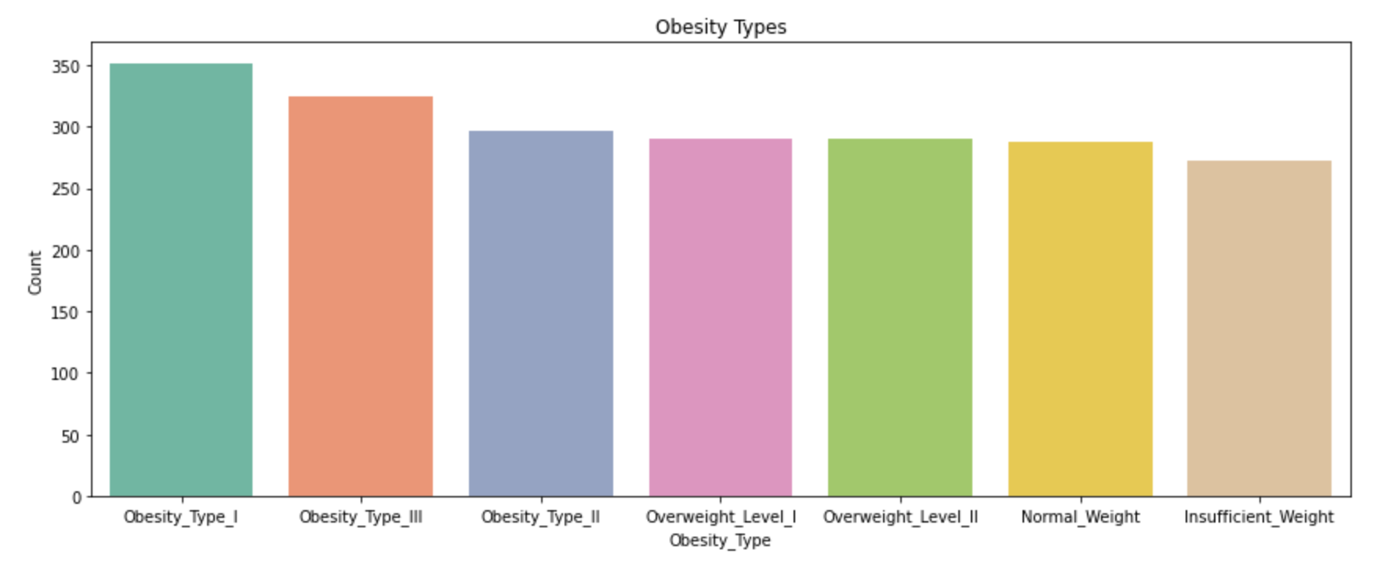
Distribution of Obesity Types (Target Feature)

Slide 6
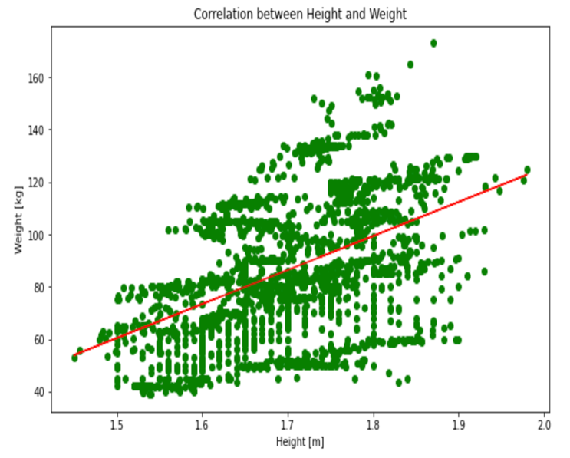
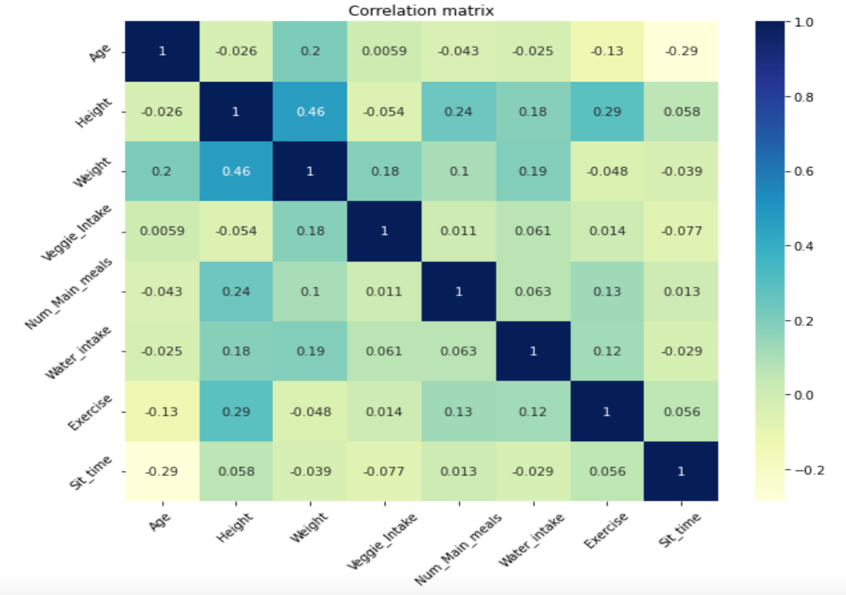
Data Analysis - 1
BMI (Body Mass Index)
Correlation between Height and Weight features is 0.46
In simpler terms, taller people tend to have higher body weights.

Slide 7
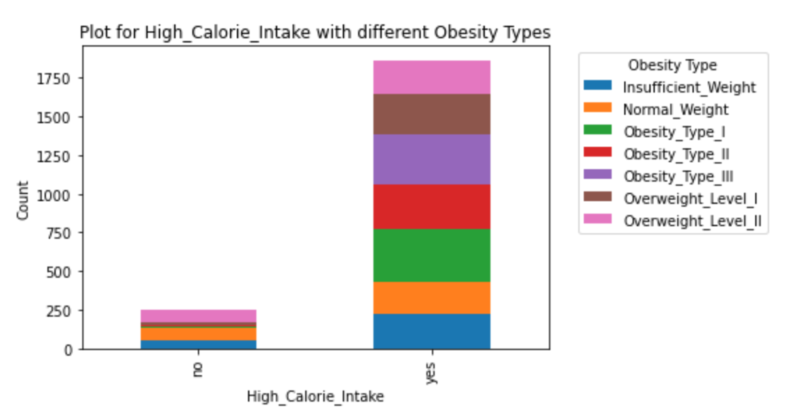
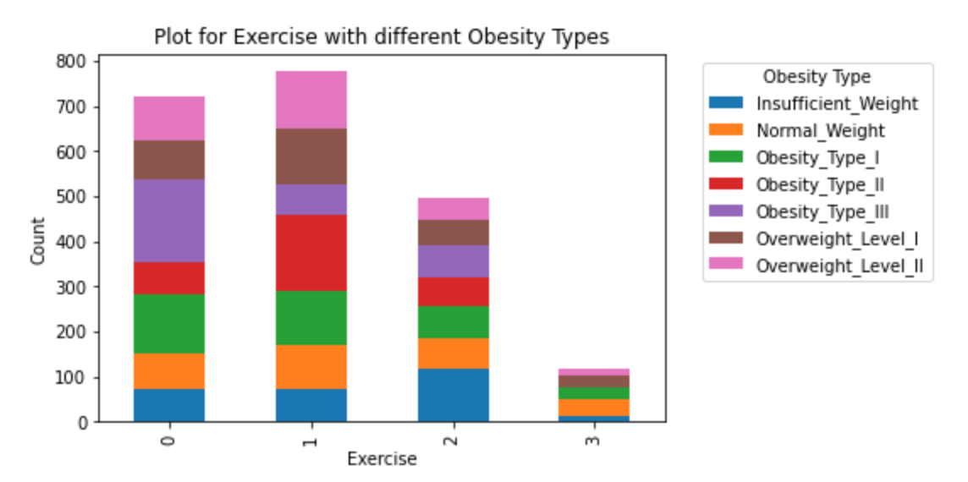
Data Analysis - 1
Weekly Exercise
0 : No exercise
1 : 1-2 days
2 : 2-4 days
3 : 4-5 days
Calorie Intake and Exercise
Most of the responses for calorie intake were affirmative.
Foods with high calorie content is a leading factor that directly influences an individual's likelihood of developing overweight or obese conditions.
Count of individuals who do not exercise at all, or do minimal exercise are higher (0 and 1).

Slide 8
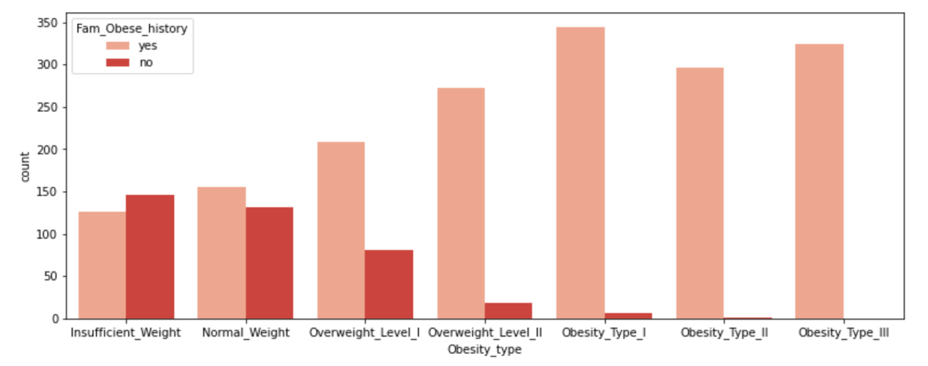
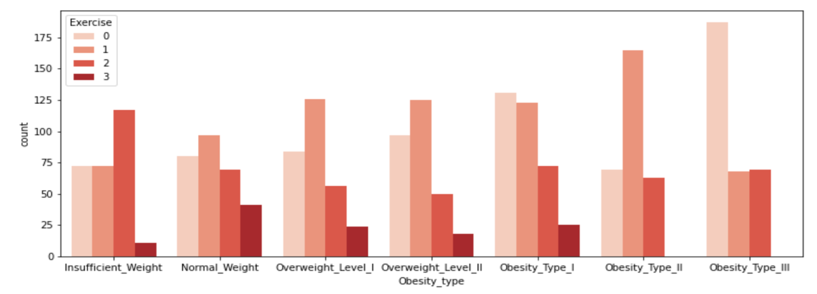
Data Analysis - 1
Family Obesity History
Individuals with Overweight Level I, II as well as with Obesity type I, II and III shows higher number compared to Insufficient and Normal weights.
Genetic factors play a role in how the body stores and uses fats, as well as how it regulates appetite and metabolism.
Exercise
Individuals with Overweight and Obesity levels do not exercise at all or have less physical activity in a week.
This sedentary lifestyle and limited physical activity can elevate the risk of obesity.

Slide 9
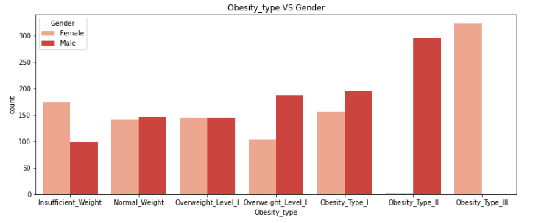
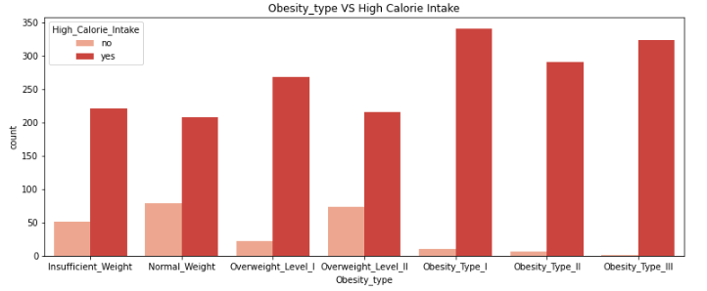
Data Analysis - 2
Gender
Women are more likely to fall into the 'Insufficient Weight’.
Men are more susceptible to higher weight categories.
'Obesity Type III’: Highly dominated by women.
Highlights the significance of considering gender as a relevant factor.
High Calorie Intake
Both 'Normal Weight' and 'Overweight/Obese,’ consume high calorie food.
Highlights the exception that high-calorie consumption does not guarantee obesity, and conversely, low-calorie consumption does not necessarily equate to a 'Normal Weight' status.

Slide 10
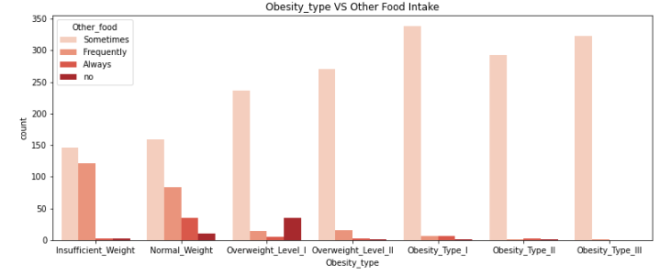
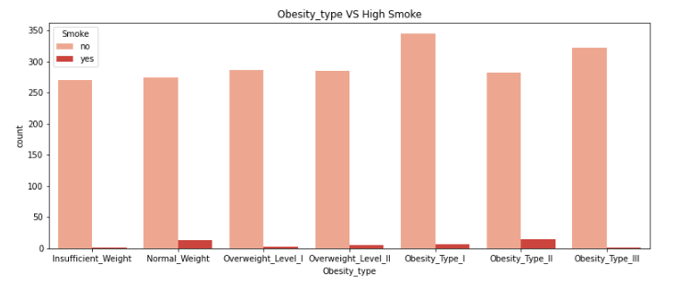
Data Analysis - 2
Other Food Intake
Indicates that individuals who report 'frequently' or 'always' indulging in between-meal snacks do not seem to exhibit abnormal weight levels.
Individuals categorized as 'Overweight' or ‘Obese' categories are predominantly those who report having snacks 'sometimes’.
This observation suggests that the frequency of snacking between meals may not be a significant factor.
Smoking Habit
It appears that smoking is not a strong predictor of body weight, as there is no clear correlation between smoking and specific weight categories.
This observation contradicts the existing research that heavy smoking could be associated with a greater risk of obesity.
However, the dataset's relatively small number of smokers may limit the ability to draw definitive conclusions.

Slide 11
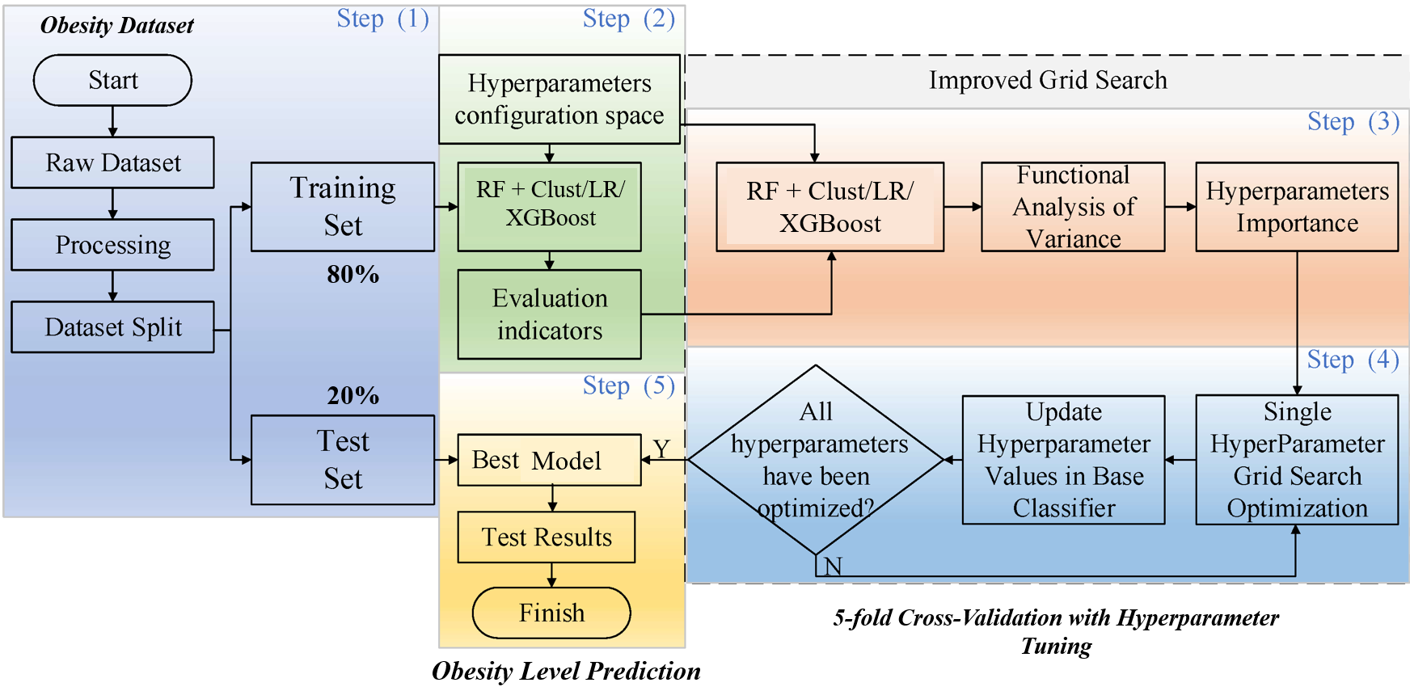
Model Architecture and Dataflow

Slide 12
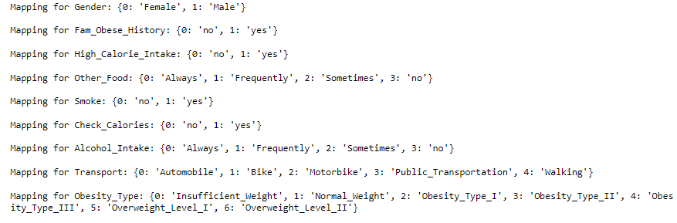

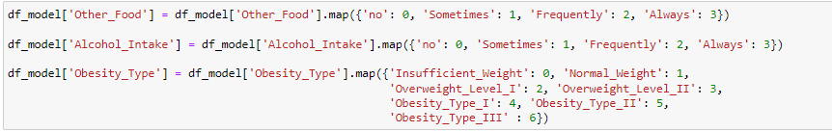
Problem: Incorrect encoding for ordinal variables by Sklearn LabelEncoder
Solution: Manual Feature Mapping for ordinal variables and one hot encoding for nominal

Slide 13
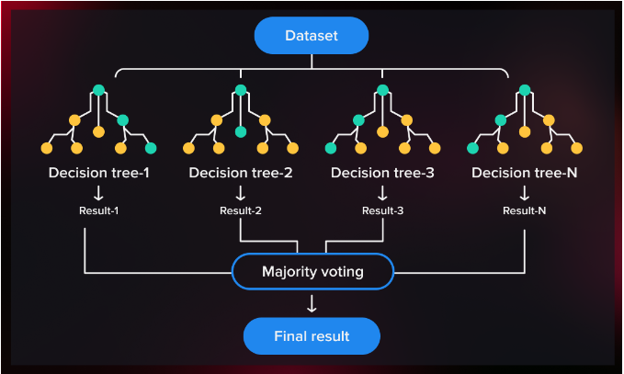
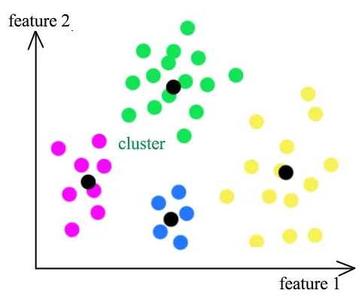
Random Forest + Clustering (Semi-Supervised Learning)
Best Features
https://serokell.io/blog/random-forest-classification
https://medium.com/@b.terryjack/tips-and-tricks-for-multi-class-classification-c184ae1c8ffc

Slide 14
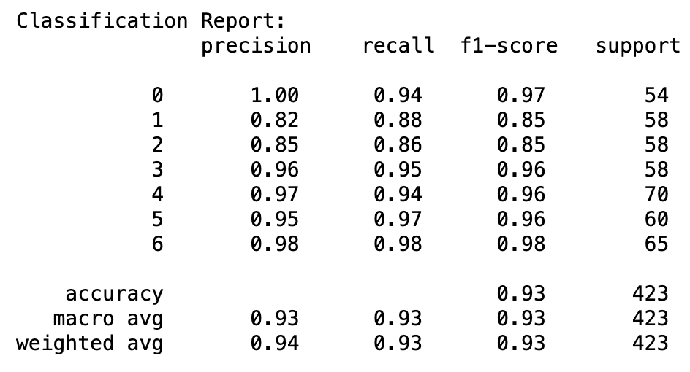
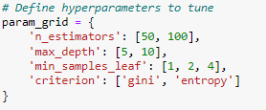
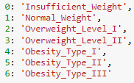
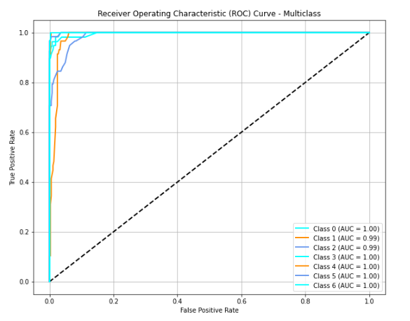
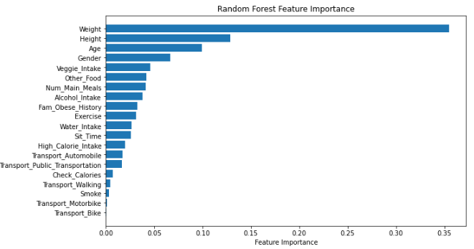
Random Forest Results

Slide 15
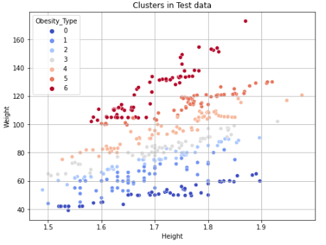
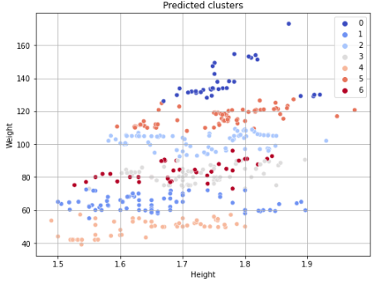
K-Means Clustering with K-means++ Initialization
RF Best features: Height & Weight
Insights:
k-means++ initialization is used to distribute initial centroids to accelerate the KMeans algorithm convergence.
Classes on both plots differ since the clustering algorithm does not know how to order them.
Nonetheless, KMeans managed to group "Height" and "Weight" points in 7 categories which very much overlap the testing labels.
This is the essence and applications of Semi-Supervised learning.

Slide 16
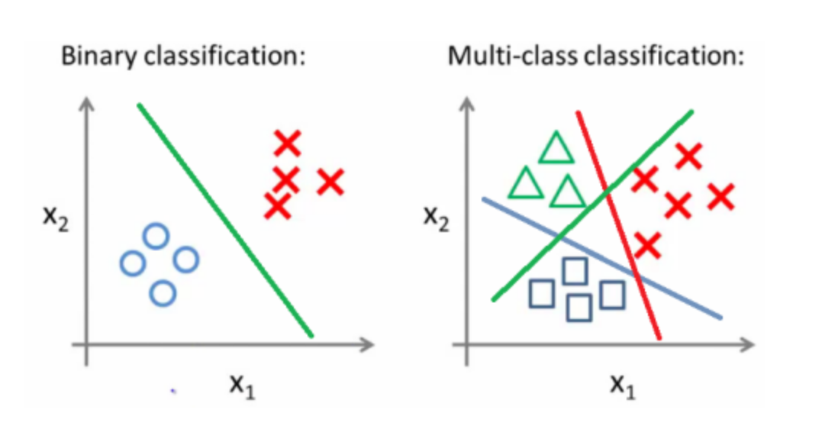
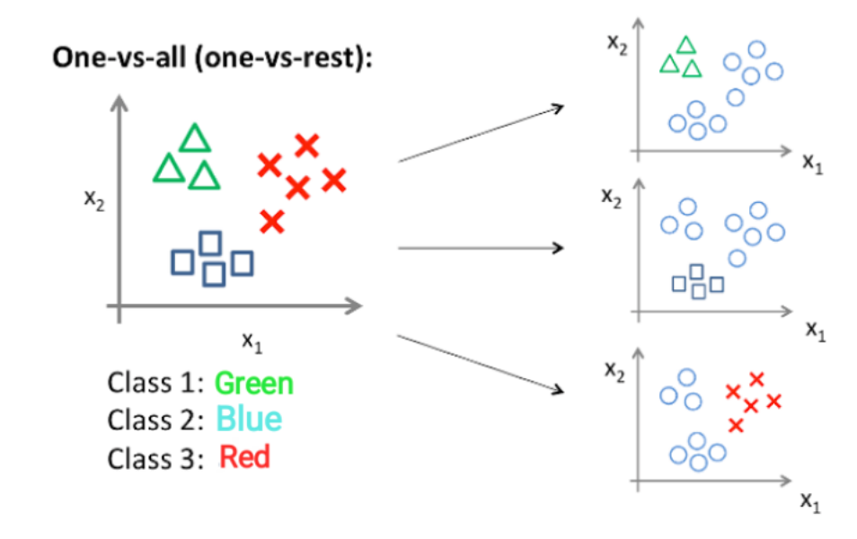
Multiclass Logistic Regression
Logistic classifiers are binary classifiers. However, Logistic regression can be applied to solve multiclass problems.
One-vs-all classification is a method which involves training N distinct binary classifiers, each designed for recognizing a particular class.
https://utkuufuk.com/2018/06/03/one-vs-all-classification/
https://www.cs.rice.edu/~as143/COMP642_Spring22/Scribes/Lect5

Slide 17

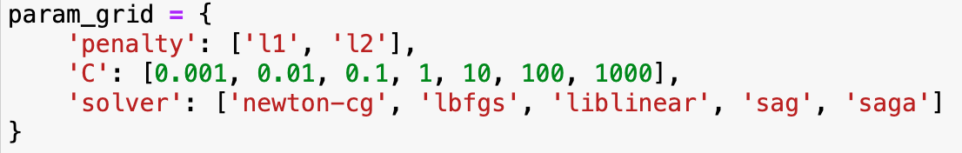
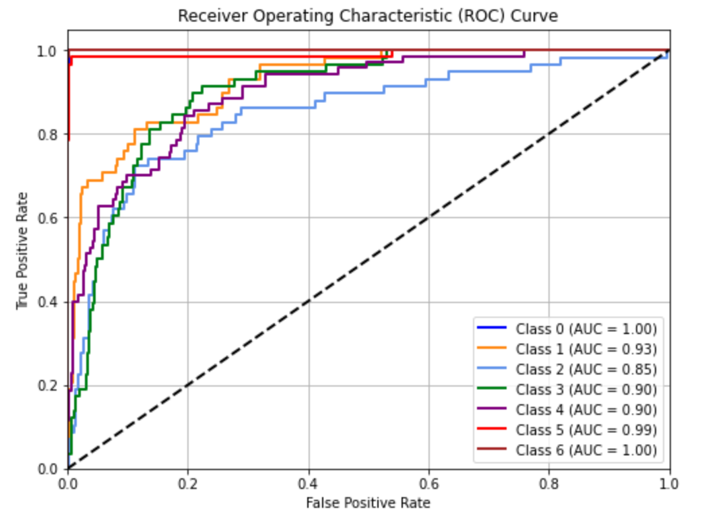
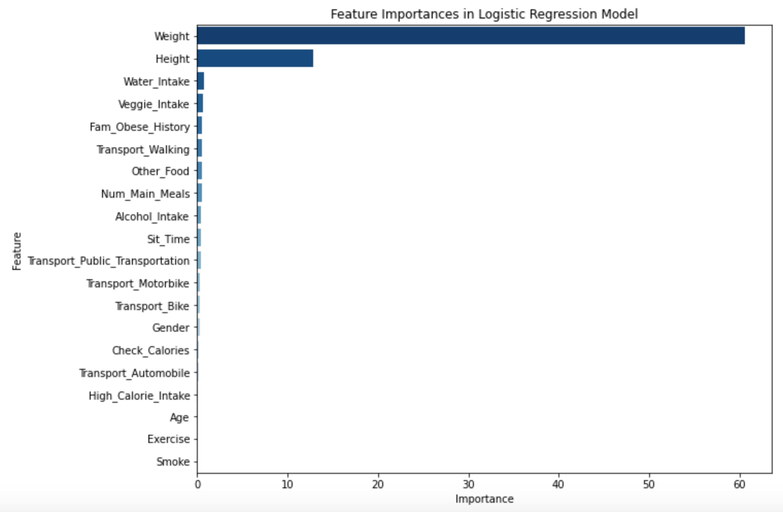
Logistic Regression Results

Slide 18
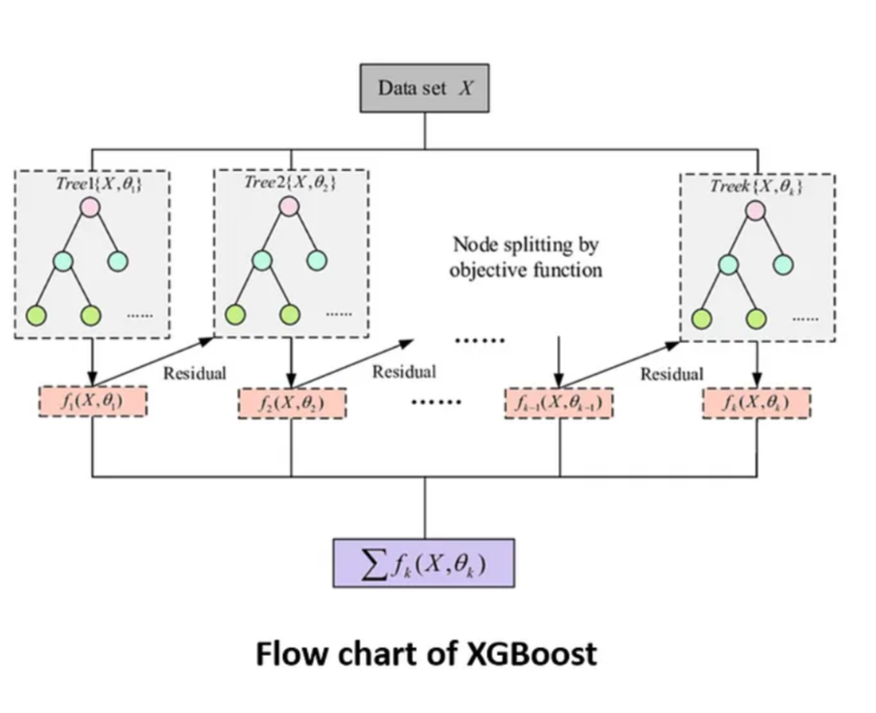
XGBoost (eXtreme Gradient Boosting)
It is based on the principle of gradient boosting, an ensemble technique where new models are added to correct the errors made by existing models.
Gradient Boosting algorithm fits the new predictor to the residual errors made by the previous predictor.
It will perform both classification and regression tasks.
It is often faster than other gradient boosting implementations and produces highly accurate models
https://easonlai888.medium.com/xgboost-or-logistic-regression-model-for-diabetes-prediction-1c3670cbbf6e

Slide 19
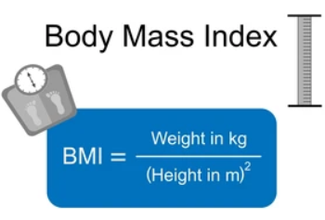
XGBoost Novel Feature Engineering Approach:
Comparison of Accuracy for Different Combinations of XGBoost:
weight
Dataset
XGBoost model
Accuracy: 94%
Height
Dataset
Model + feature engineering
Accuracy: 97%
Model | Best parameters | Accuracy (%) | Feature Importance Details | Comments
XGBoost + Hyperparameter Tuning | 'learning_rate': 0.1, 'max_depth': 4, 'n_estimators’: 200 | 94.79 | Weight, height, age | Implemented XGBoost model by performing hyperparameter tuning. Observed that there is no change in the accuracy.
XGBoost + Feature Engineering | ‘learning_rate': 0.2, 'max_depth': 3, 'n_estimators': 100 | 97.40 | BMI, Gender, Transport_public | Performed feature engineering using Weight and Height columns to create a new column ‘BMI’ Increase in accuracy to 97.40.

Slide 20
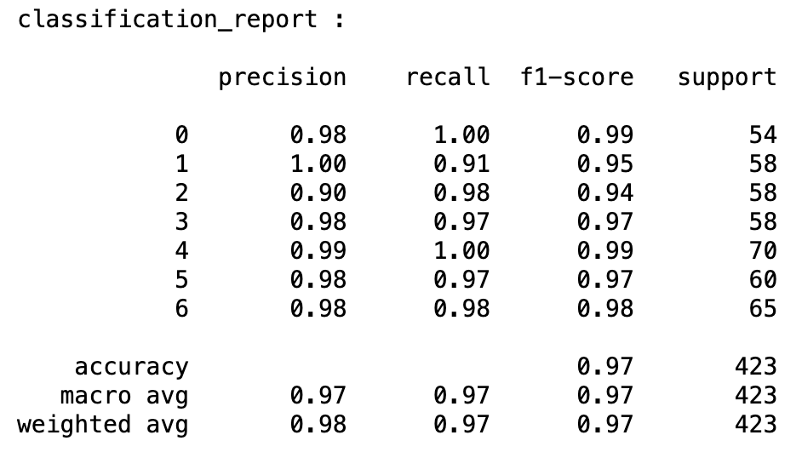
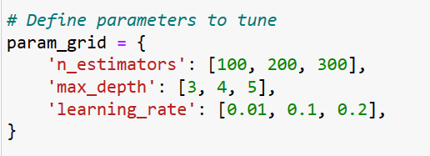
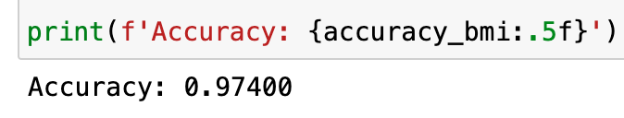
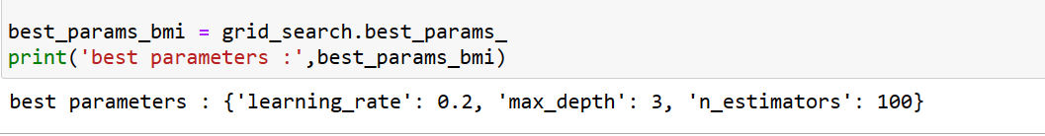
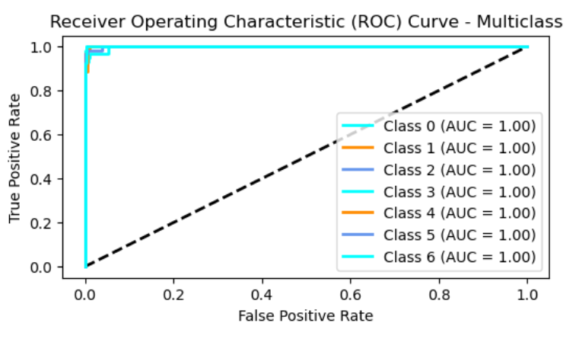
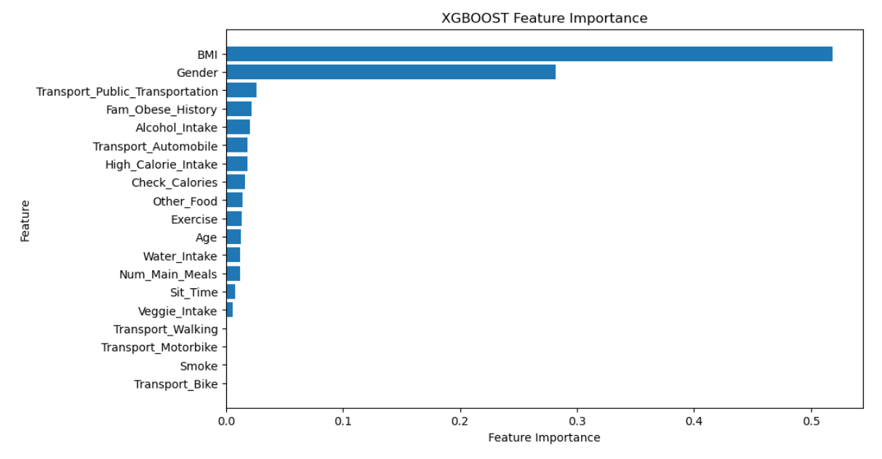
XGBoost Results

Slide 21
Conclusions and Achievements
Through effective data analysis, our project highlights the complicated and multifaceted nature of the factors influencing obesity.
It emphasize the need for a holistic approach to understand and address weight-related issues, ultimately recognizing that no single factor can fully explain the variations in weight categories.
The semi-supervised approach (Random Forest and Clustering), offers a novel perspective for handling real-world unlabeled data, emphasizing the importance of Semi-Supervised Learning.
XGBoost outperformed all other models through a unique feature engineering approach by creating a new feature (BMI) by combining Height and Weight resulting in higher accuracy.
Ultimately, our project takes a step beyond data analysis, offering tangible contributions in terms of:
Early Detection and Prevention
Advancements in Scientific Knowledge
Enablement of Personalized Healthcare

Slide 22
References
[1] E. Laurence, “Obesity statistics,” Forbes, 13-Jun-2023. [Online]. Available: https://www.forbes.com/health/body/obesity-statistics/. [Accessed: 26-Oct-2023].
[2] Safaei, M., Sundararajan, E. A., Driss, M., Boulila, W., & Shapi’i, A. (2021). A systematic literature review on obesity: Understanding the causes & consequences of obesity and reviewing various machine learning approaches used to predict obesity. Computers in Biology and Medicine, 136(104754), 104754. doi:10.1016/j.compbiomed.2021.104754
[3] Ali Alsareii, S., Awais, M., Manaa Alamri, A., Yousef AlAsmari, M., Irfan, M., Raza, M., & Manzoor, U. (2023). Machine-learning-enabled obesity level prediction through electronic health records. Computer Systems Science and Engineering, 46(3), 3715–3728. doi:10.32604/csse.2023.035687
[4] “UCI machine learning repository,” Uci.edu. [Online]. Available: https://archive.ics.uci.edu/dataset/544/estimation+of+obesity+levels+based+on+eating+habits+and+physical+condition. [Accessed: 26-Oct-2023].
[5] F. Ferdowsy, K. S. A. Rahi, Md. I. Jabiullah, and Md. T. Habib, “A machine learning approach for obesity risk prediction,” Current Research in Behavioral Sciences, vol. 2, p. 100053, Nov. 2021, doi: 10.1016/j.crbeha.2021.100053.
[6] J. Jeon, S.-M. Lee, and C.-O. Oh, “Age-specific risk factors for the prediction of obesity using a machine learning approach,” Frontiers in Public Health, vol. 10, Jan. 2023, doi: 10.3389/fpubh.2022.998782.
[7] S. A. Thamrin, D. S. Arsyad, H. Kuswanto, A. Lawi, and S. Nasir, “Predicting obesity in adults using Machine Learning techniques: An analysis of Indonesian Basic Health Research 2018,” Frontiers in Nutrition, vol. 8, Jun. 2021, doi: 10.3389/fnut.2021.669155.
[8] Aguirre Rodríguez, Elias & Rodríguez, Elen & Nascimento, Luiz & Silva, Aneirson & Marins, Fernando. (2021),“ Machine learning Techniques to Predict Overweight or Obesity,”https://www.researchgate.net/publication/362544127
[9] Lim, H., Lee, H. & Kim, J,“ A prediction model for childhood obesity risk using the machine learning method: a panel study on Korean children,” Sci Rep 13, 10122 (2023). https://doi.org/10.1038/s41598-023-37171-4.
[10] F. M. Palechor and A. de la H. Manotas, “Dataset for estimation of obesity levels based on eating habits and physical condition in individuals from Colombia, Peru and Mexico,” Data Brief, vol. 25, no. 104344, p. 104344, 2019.

Slide 23
THANK YOU!

